Slide 1
Who Killed My Pod? #whodunit
- Suneeta Mall
Notes:
This is Kube Crime Scene Investigation report!

Slide 2

Every intriguing investigation begins with a disaster!

Slide 3
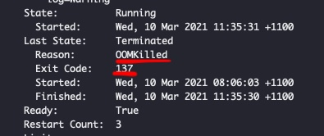
$ kubectl apply –f my_pixie_dust_magical_app.yaml
Suffice to say – All hell broke loose!

Slide 4
The serial killer investigation board
Pattern: A particular container – a standard Linux process
Weapon: SIGKILL
Nature: Forceful & Brutal
Trigger: Dislike for potential memory hogging

Slide 5
Investigation: Container runtime (CR)
Container A
Container B
Docker Engine
Containerd
High level runtime – deals with image management and higher-level APIs
Runc
Low level runtime – deals with system calls, Name space, cgroups
Host

Slide 6
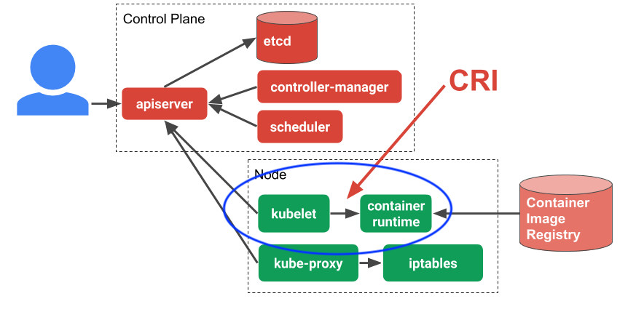
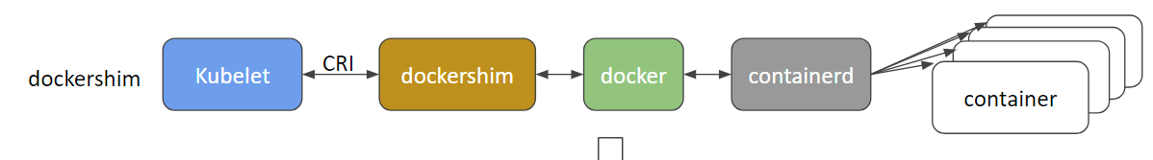
Investigation: Kubernetes & CRI
So, whodunit?
a) Manual intervention
b) Kubelet
c) OS Kernel
Also has cadvisor to captures resource utilization, statistics about control group of all container processes on the host.
Picture credit: Ian Lewis
*Shim in being removed in coming releases k1.20+ https://kubernetes.io/blog/2020/12/02/dont-panic-kubernetes-and-docker/

Slide 7
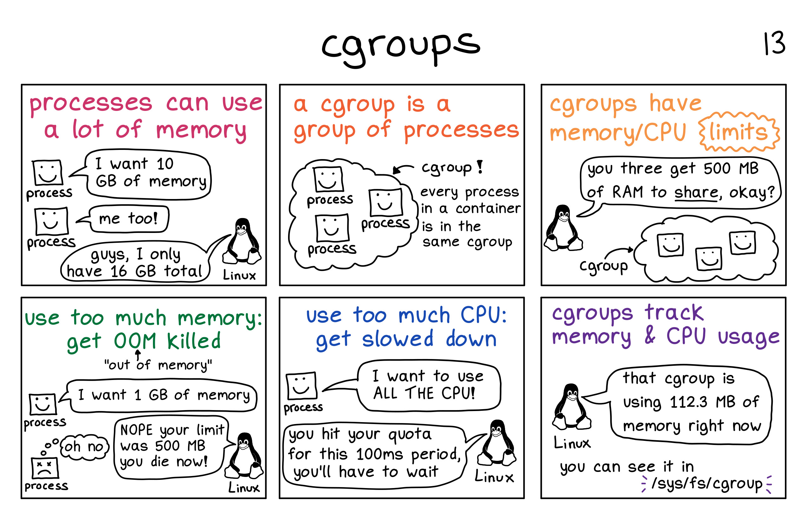
Investigation Why
Container isolation is ensured by using Linux Namespace & cgroups.
Namespace: for file system, Networking, etc
Cgroups: CPU, Memory, & other resource level isolation
Julia Evans’s zines

Slide 8
Demo of cgroup
Notes:
On mac:
docker run --name limitless_kcsi -d --entrypoint /home/gitpod/mambaforge3/envs/numpy-dev/bin/ipython -t -i numpy/numpy-dev\n
docker run --name 20m_limit_kcsi --memory=20m -d --entrypoint /home/gitpod/mambaforge3/envs/numpy-dev/bin/ipython -t -i numpy/numpy-dev\n
docker run --name 20m_strict_limit_kcsi --memory-swap=20m --memory=20m -d --entrypoint /home/gitpod/mambaforge3/envs/numpy-dev/bin/ipython -t -i numpy/numpy-dev\n
docker ps -a
docker inspect 59a00d7088bb
Explain swap n oom kill
On server no swap:
cat /sys/fs/cgroup/memory/memory.limit_in_bytes
cat /sys/fs/cgroup/memory/docker/memory.limit_in_bytes
> No memory limit
9223372036854771712 <- longest int64 in multiple of page size 4kb.
> Notice process hierarchy
1.
docker run --name limitless_kcsi -d --entrypoint /home/gitpod/mambaforge3/envs/numpy-dev/bin/ipython -t -i numpy/numpy-dev
docker ps -a | grep kcsi
docker ps --filter "name=limitless_kcsi" --format "{{.ID}}" --no-trunc
cat /sys/fs/cgroup/memory/docker/$(docker ps --filter "name=limitless_kcsi" --format "{{.ID}}" --no-trunc)/memory.limit_in_bytes
2.
docker run --name 20m_limit_kcsi --memory=20m -d --entrypoint /home/gitpod/mambaforge3/envs/numpy-dev/bin/ipython -t -i numpy/numpy-dev
cat /sys/fs/cgroup/memory/docker/$(docker ps --filter "name=20m_limit_kcsi" --format "{{.ID}}" --no-trunc)/memory.limit_in_bytes
cat /sys/fs/cgroup/memory/docker/$(docker ps --filter "name=20m_limit_kcs" --format "{{.ID}}" --no-trunc)/memory.swappiness
> Notice 0 swap
3.
docker run --name 20m_strict_limit_kcsi --memory-swap=20m --memory=20m -d --entrypoint /home/gitpod/mambaforge3/envs/numpy-dev/bin/ipython -t -i numpy/numpy-dev
> Show oomkill
docker inspect 20m_strict_limit_kcsi
cat /sys/fs/cgroup/memory/docker/$(docker ps --filter "name=name 20m_strict_limit_kcsi " --format "{{.ID}}" --no-trunc)/memory.swappiness
cat /sys/fs/cgroup/memory/docker/$(docker ps --filter "name=name 20m_strict_limit_kcsi " --format "{{.ID}}" --no-trunc)/memory.limit_in_bytes
cat /sys/fs/cgroup/memory/docker/$(docker ps --filter "name=name 20m_strict_limit_kcsi " --format "{{.ID}}" --no-trunc)/memory.swappiness
=== Explain on node server
ls -al /sys/fs/cgroup/memory/kubepods/pod65b30ee4-f683-4c9c-99a0-07ef7c0ffe95
2 container
>> OOM Kill
ps $(docker inspect -f '{{.State.Pid}}' $(docker ps --filter "name=limitless_kcsi" --format "{{.ID}}" --no-trunc))

Slide 9
Demo of OOM Score
Notes:
>> OOM Kill
ps $(docker inspect -f '{{.State.Pid}}' $(docker ps --filter "name=limitless_kcsi" --format "{{.ID}}" --no-trunc))
cat /proc/30546/limits
cat /proc/30546/oom_score
cat /proc/30546/oom_score_adj
cat /proc/30546/oom_adj

Slide 10
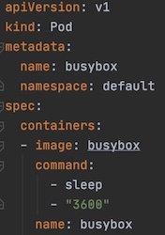
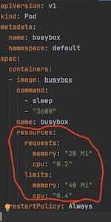
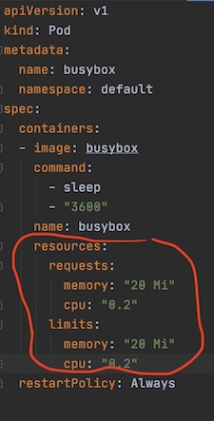
Kube: QoS & Resource requests & limits
QoS: Best Effort
Most likely to get killed
QoS: Burstable
Less likely to get killed
QoS: Guaranteed
Least likely to get killed

Slide 11
Kube: Resources & commitments
Compressible resources: When resource limit is reached, Kube will throttle the container but won’t terminate the container. E.g. CPU
Incompressible resources: When resource limit is reached, the highest usage process within the cgroups hierarchy will be killed. E.g. Memory
So, can kube overcommit? How about linux kernel?

Slide 12
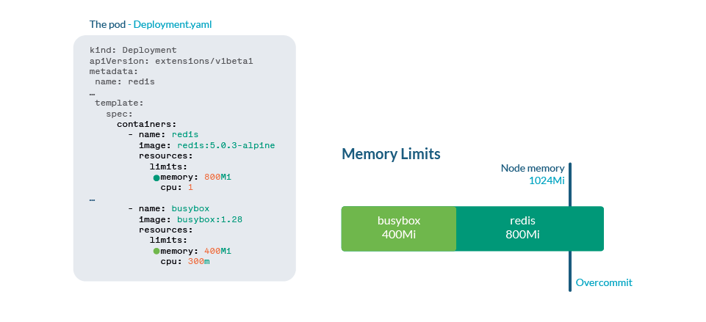
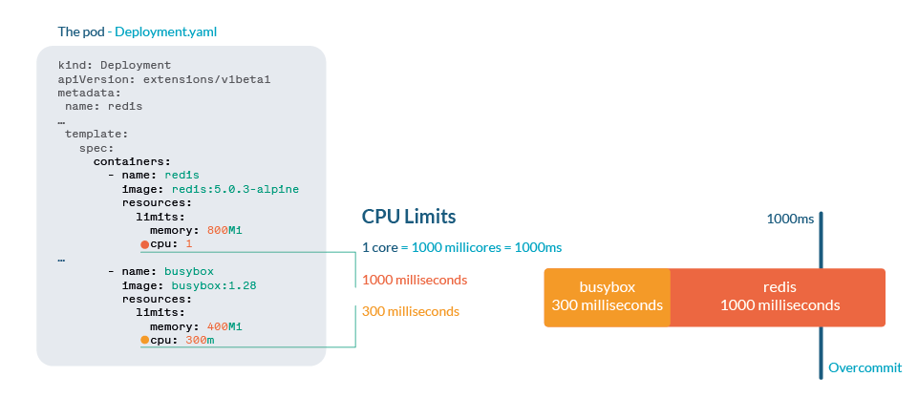
Over-committal: It’s a feature not a bug!
But swaps are disabled (for right reasons)!
Credit: https://sysdig.com/blog/troubleshoot-kubernetes-oom/

Slide 13
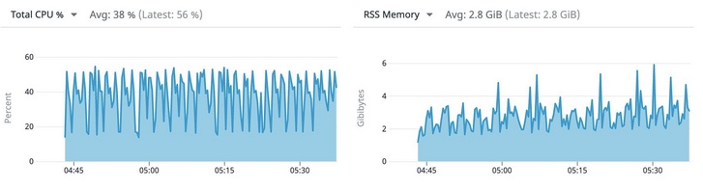

Data from crime scene!
At no point, node is found to under duress.
QoS Guaranteed
Pod
Pod
System reserved
31 GB
31 GB
2 GB
Still OOMKill!
64 GB
r5.2xlarge: 8CPU

Slide 14
The serial killer investigation board
Nature: Forceful & Brutal
Protecting potential victim containers with guaranteed QoS is no joy
Weapon: SIGKILL
Pattern: A particular container – a standard Linux process
Container otherwise behaves reasonably
Suspects: Kublets/OS Kernel
Trigger: Dislike for potential memory hogging
Potentially related to overcommittal

Slide 15
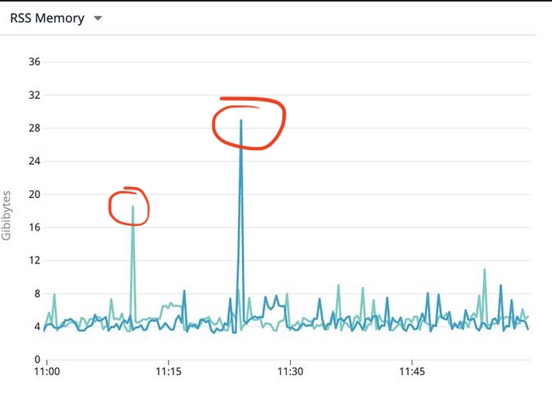
Critical evidence
Rare occurrence of memory spike observed at “28.x Gi/31Gi request”
Lot less frequency than kills
Still within bounds of memory limits
So who is killing the pods! #whodunit

Slide 16
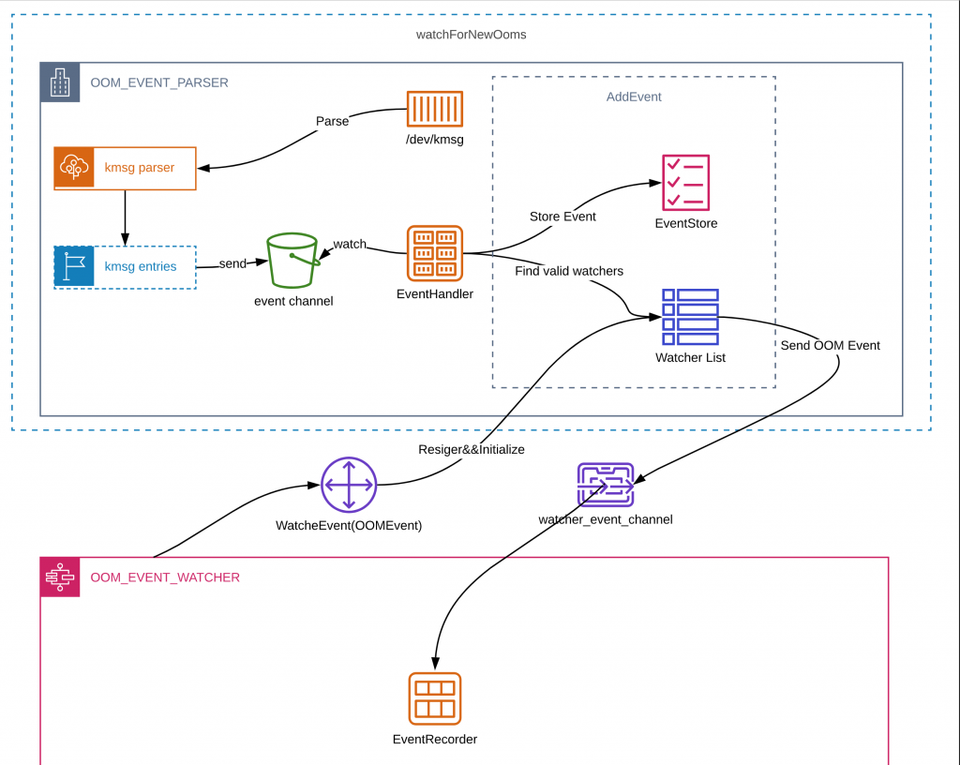
OOM workflow
Image credit Line Corp
OOMEvent
OOMKillEvent
Notes:
/proc/kmsg: like pseudo-FIFO, read by multiple clients because it is read-once.
/dev/kmsg: is more like stream logs read/write stream my multiple clients

Slide 17

Kube is all hakuna matata!
Nada in application logs
Nada in Kubernetes pod and deploy Events log
Nada in Kubelet logs
journalctl -u kubelet | grep -i "Out of memory”
journalctl -u kubelet | grep -i "oom”

Slide 18
The serial killer investigation board
Nature: Forceful & Brutal
Protecting potential victim containers with guaranteed QoS is no joy
Weapon: SIGKILL
Pattern: A particular container – a standard Linux process
Suspects: Kublets/OS Kernel
There is a memory event & unexplained kill
Trigger: Dislike for potential memory hogging
Potentially related to overcommittal

Slide 19
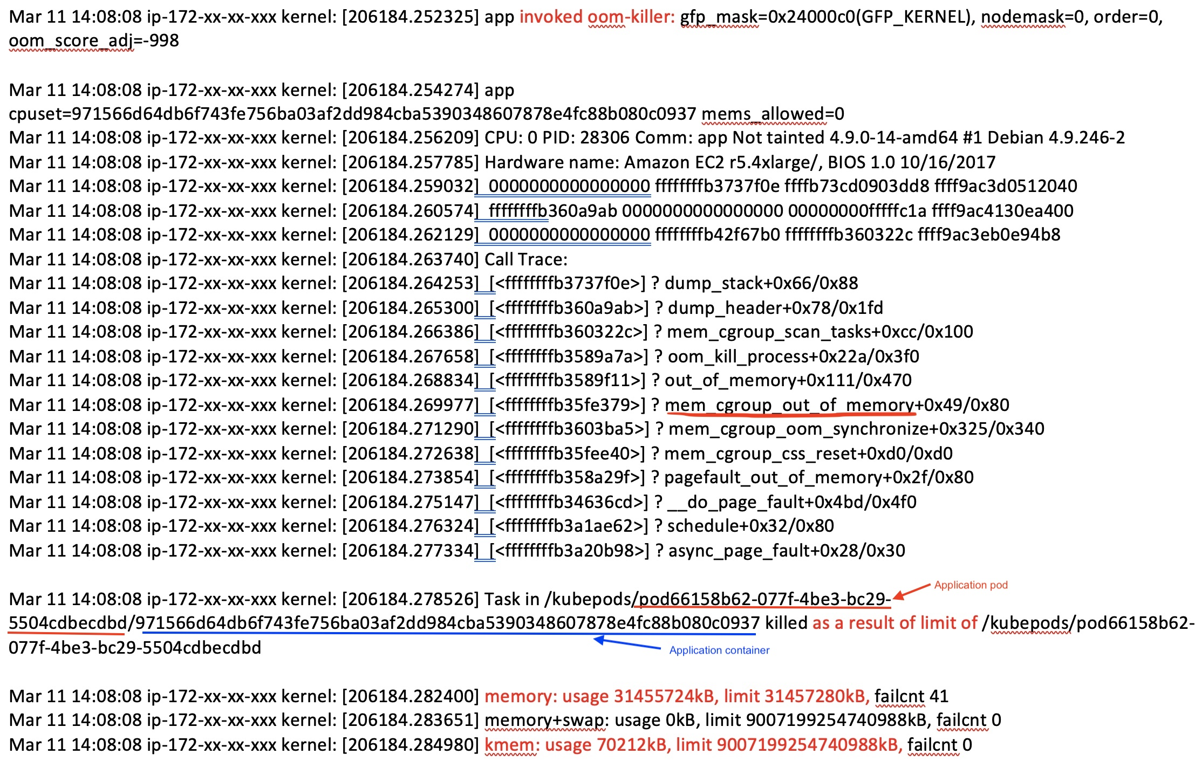
Evidence collection
“grep -i -r 'out of memory' /var/log/” indicated following logs:
> /var/log/kern.log:Mar 9 13:17:05 ip-172-xxx-xx-xxx kernel: [30320.358563] Memory cgroup out of memory: Kill process 11190 (app) score 9 or sacrifice child

Slide 20
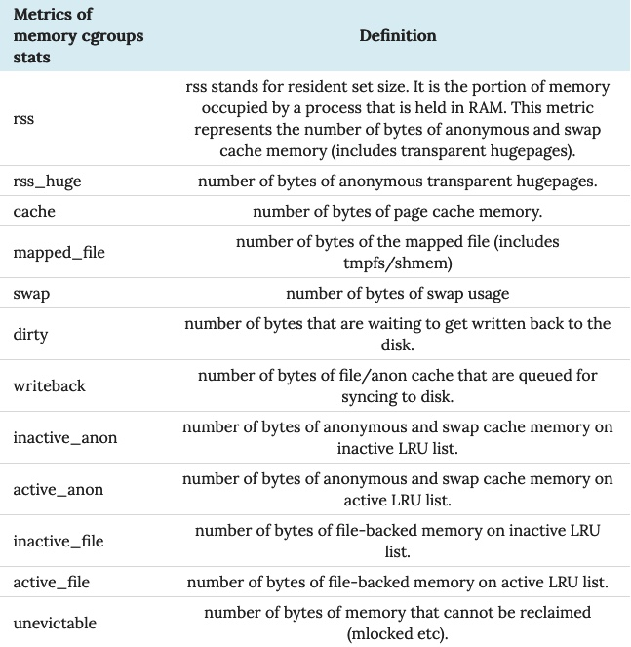
Metrics of memory cgroups stats
anonymous memory (abbr. anon) is a memory mapping with no file or device backing it.
Anon memory is used by programs to allocate memory for the stacks and heaps.
Also, the standard page size on the Linux kernel is 4KB which can be really inefficient to store mapping for a large block of memory virtual memory.
Hugepages are designed to solve this inefficiency and can hold a bigger chunk than 4KB.

Slide 21
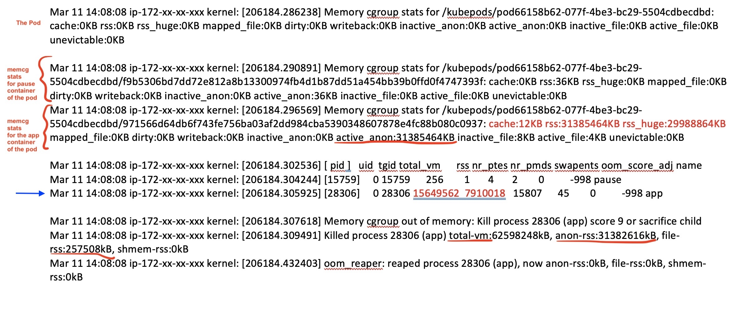
almighty-pause-container by Ian Lewis

Slide 22

Exactly why?

Slide 23
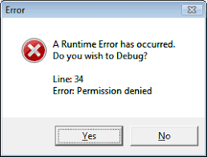

Desired behavior:
Fail safely
Recover gracefully

Slide 24
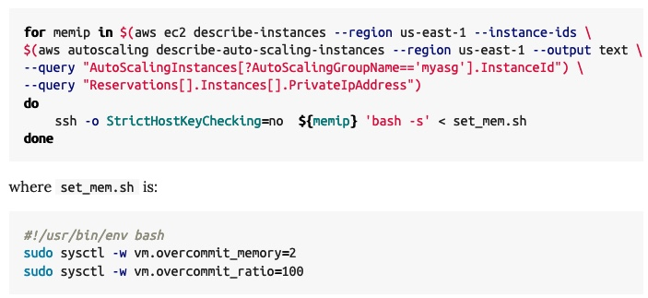
Fix 1:
Disable overcommit at OS level:
sysctl -w vm.overcommit_memory=2
sysctl -w vm.overcommit_ratio=100
Allows handling this as application error – more reliably than runtime crash on one likes!
Kube allows `sysctlparameters` control to modify these setting from k.18+ but overcommittal can’t be disabled!

Slide 25
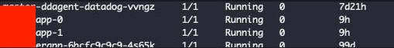
The serial killer investigation board
Nature: Forceful & Brutal
Protecting potential victim containers with guaranteed QoS is no joy
Weapon: SIGKILL
Pattern: A particular container – a standard Linux process
Suspects: Kublets/OS Kernel
There is a memory event & unexplained kill
Unsub identified: OS Kernel
Trigger: Dislike for potential memory hogging
Potentially related to overcommittal

Slide 26
Finally
Review of applications memory footprint & memory chunking

Slide 27
Conclusion
Container was killed because it was reaching its memory limit of ~#! GB
It was killed by OS Kernel
To mitigate the issue: we disabled over-committal of VM
To fix the issue: we reduced memory footprint of the app and use more chunking

Slide 28
Thank you

